Slide 1




Business/marketing Analytics using Tableau and R (or R Studio) - case study - Avocado pricing and sales– Oct 2022
Zhenning "Jimmy" Xu, Ph.D. in Business Administration Assistant Professor of Marketing California State University, Bakersfield P(office): 661.654.3505 E: zxu3@csub.edu W: http://rpubs.com/utjimmyx W: https://public.tableau.com/profile/zhenning.xu#!/
W: https://github.com/utjimmyx Twitter: https://twitter.com/MKTJimmyxu

Slide 2

Agenda
Mid-semester wrap-up
Learning objectives
Business challenges and opportunities
Why Tableau?
Tableau vs. R (or R Studio)
Case studies
Avocado case study – solutions built using Tableau – (TPS based on the dashboard we built together this past Monday)
Avocado case study – solutions built using R and R studio
Avocado case study – other solutions
Next steps & additional resources

Slide 3
Mid-semester wrap-up - Do not forget to add R (or R Studio) to your LinkedIn page
R (or R Studio) is the number one most demanded skill in Marketing/Business Analytics
Ref: Using RStudio to Amplify Digital Marketing Results. https://www.rstudio.com/blog/using-rstudio-to-amplify-digital-marketing-results/
Why R should be part of your marketing toolbox - From pivot table-like functions and graphing to web-scraping, sentiment analysis and machine learning. And it’s free. - https://medium.com/@chrisBow/why-r-should-be-part-of-your-marketing-toolbox-875bd369006
We have done about 9 tutorials using R Studios so far! It is about building your portfolio step by step (or week by week)
please consider adding your portfolio to your LinkedIn page for your next job application
https://rpubs.com/ShibbolethRodriguez
Next step - Interested in participating in the 2023 Business Analytics Competition
https://news.csub.edu/csubs-first-team-participated-in-2021-virtual-business-analytics-competition
https://news.csub.edu/csub-holds-first-digital-marketing-and-business-analytics-hackathon

Slide 4
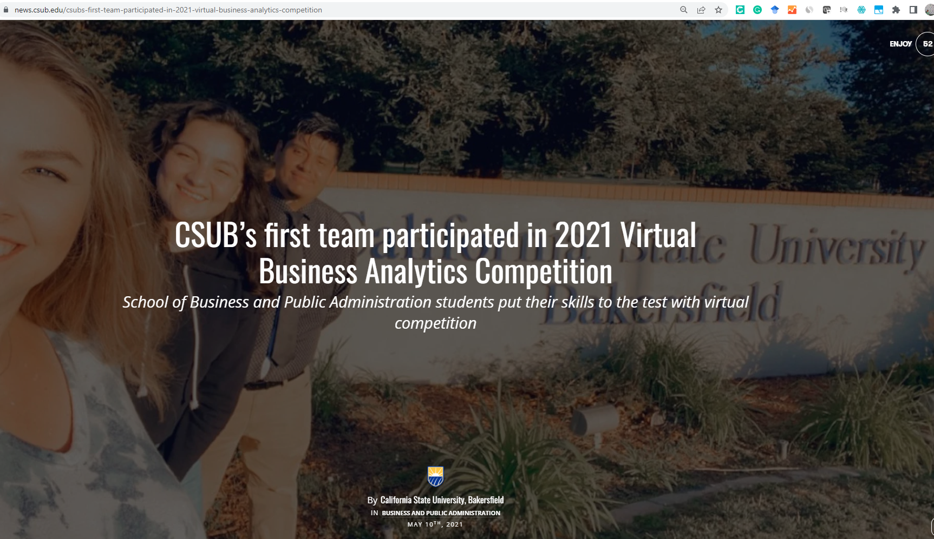
CSUB’s first team participated in 2021 Virtual Business Analytics Competition

Slide 5
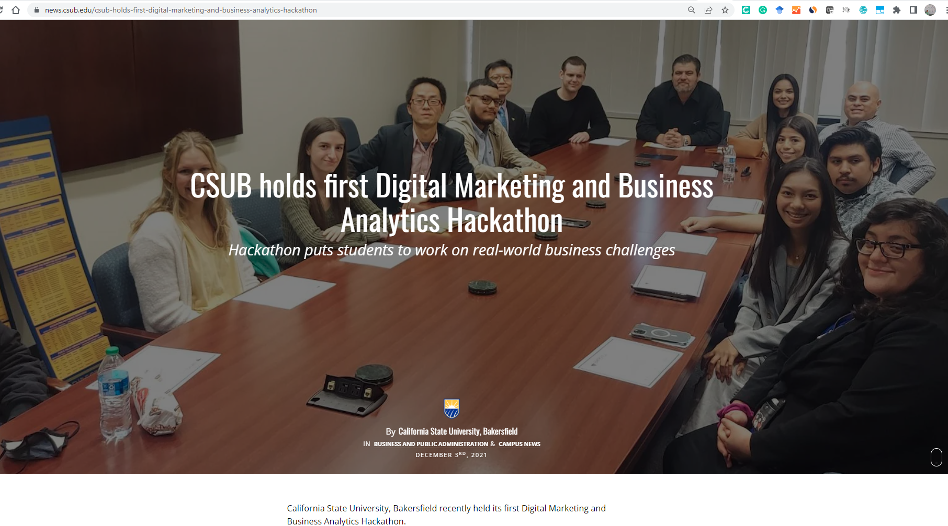
CSUB holds first Digital Marketing and Business Analytics Hackathon

Slide 6
The course certificates offered by Google/Coursera and DataCamp
Your progress on the 1st Google Data Analytics certificate course?
The following is an update (or reminder) about the 2nd course certificate (required for grading purposes)
We re-introduced the following DataCamp certificate course at the beginning of October (link available here)
This course will take you about 4 hours to finish.
The course is also for free. Just use the link available in the article.
The tentative due date for this DataCamp course is going to be Nov 5th – I suggest that you start with this one first if you have not received your approval from Google and Coursera about your 1st certificate.
You can also retake it again in case you do not do well on your first attempt.
You will get a highly recognized industrial course certificate for free.
The announcement about the 2nd course certificate posted on 10/18 - since it takes you 4-5 weeks to work on the 1st course at Coursera.com for free, the 2nd Google Data Analytics course will be replaced by the following course available at “DataCamp” - link available in the section named “CAREER TRACK | Data Analyst with R—no experience required.” (ref: https://www.r-bloggers.com/2022/10/unlock-your-data-driven-future-with-datacamps-analyst-takeover/)
Set yourself apart from your competition. Build confidence. Having a growth mindset is the key!!! You can do it. Make an impression on your future boss! Your lifelong career breakthrough opportunity starts here.
Q&As

Slide 7
Learning objectives
Upon successful completion of this module, you will be able to or will have:
Build and manage interactive marketing dashboards for performance evaluation
Gained an understanding of the use of data visualization techniques
Understand what visual qualities are important to conveying data
Manage and analyze data suing Tableau software
Manipulate and create visualizations and dashboards in Tableau
Utilize Tableau to support decision making and communicate with decision makers
Build a Tableau profile for your job-seeking purposes (see my portfolio page below) - https://public.tableau.com/profile/zhenning.xu#!/
Understand the basics for an internship position that requires BI or Tableau operations
Associate Analyst, Ranch Support - Wonderful Orchards Company Location Bakersfield, California Area - https://www.linkedin.com/jobs/view/1541359082/
Project Logistics Coordinator, Company NameFieldCore Company Location Bakersfield, CA, US - https://www.linkedin.com/jobs/view/1590368875/
Get a 1-year license for free ($1800 value)
https://www.tableau.com/about/blog/2017/8/3-steps-make-most-your-free-student-license-75791

Slide 8
Tableau (or R Studio) could be the best hard skill for your next career move
Open Happiness though Business Intelligence and Tableau at Coca-Cola - https://www.youtube.com/watch?v=GnrFHIJk2Ok&t=298s
The 10 Technical Skills With Explosive Growth In Job Demand - https://www.forbes.com/sites/jeffkauflin/2017/01/08/the-10-technical-skills-with-explosive-growth-in-job-demand/#45700fbd4f5c
Tableau Conference – Nov 9-11, 2022 (free)
https://www.tableau.com/events/conference
YouTube video - https://www.tableau.com/academic/students
https://www.tableau.com/interactive-resume-gallery
Do not forget to add Tableau and R (or R Studio) to your LinkedIn page
https://klaxos.com/best-linkedin-profile-examples/business-intelligence/

Slide 9
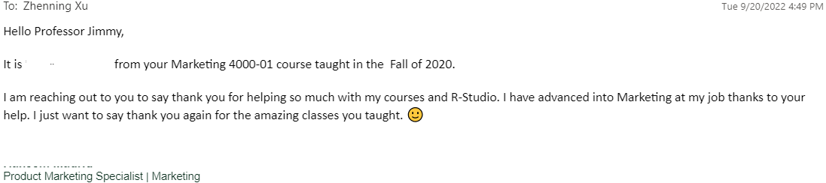
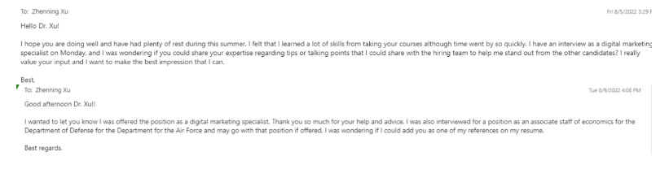
Tableau (or R Studio) could be the best hard skill for your next career move

Slide 10
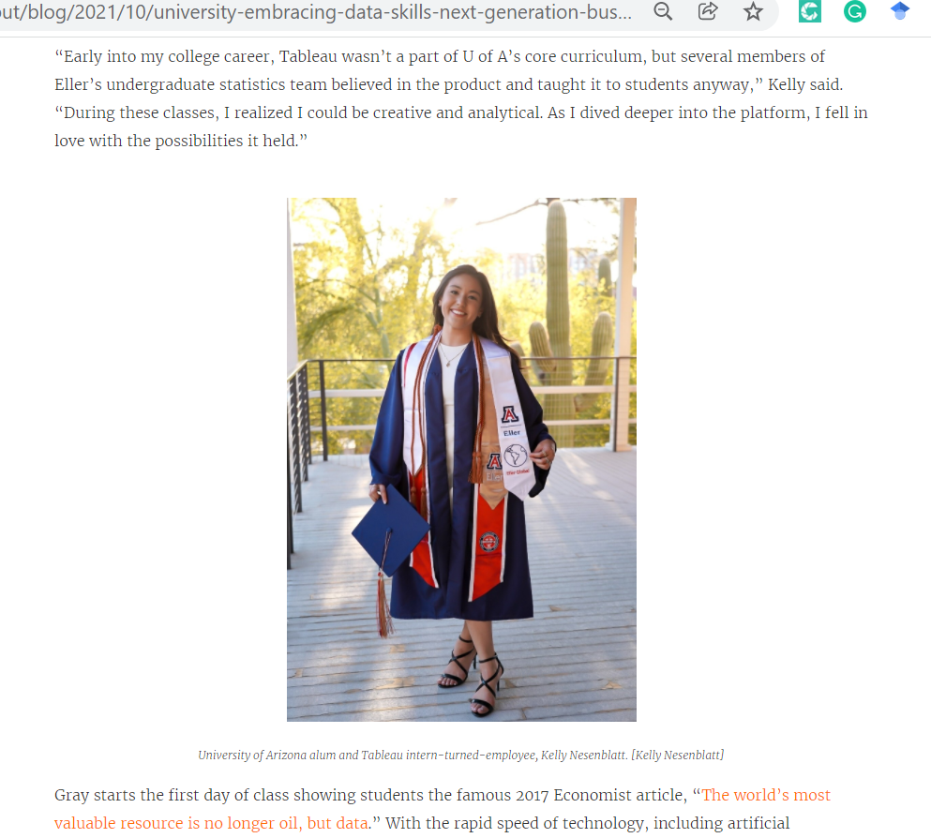
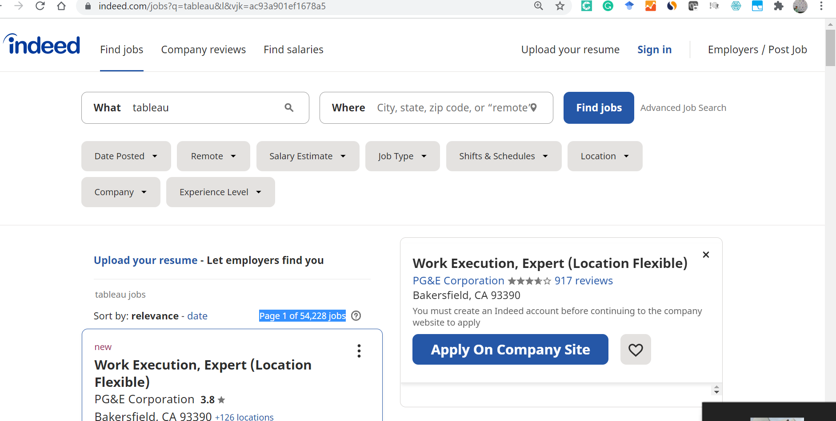
Why Tableau?
Ref: https://www.tableau.com/about/blog/2021/10/university-embracing-data-skills-next-generation-business-leaders
https://www.tableau.com/about/blog/2022/9/introducing-tableau-ambassadors-2022

Slide 11
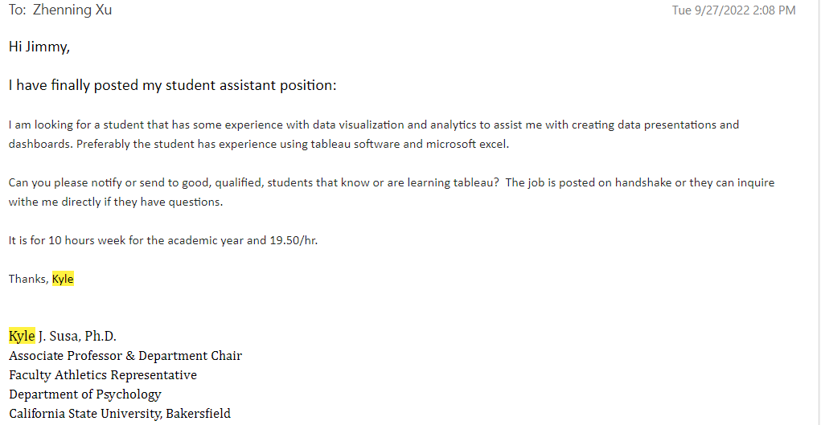
Are you ready for this GA position?

Slide 12
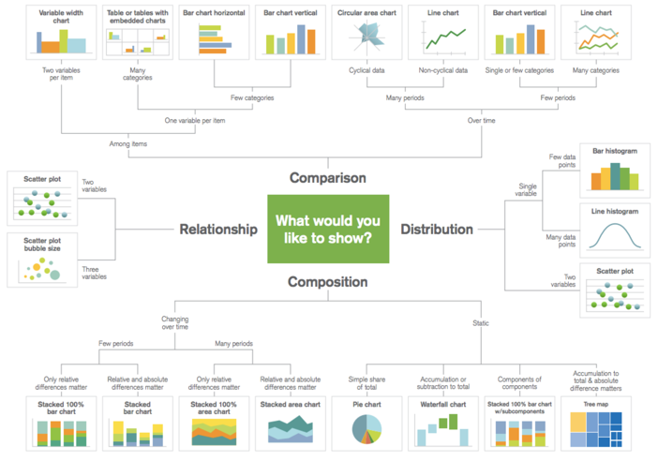
Do I have the right solution for the business problem ?

Slide 13
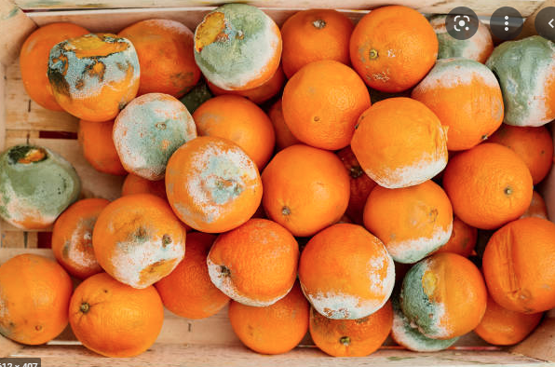
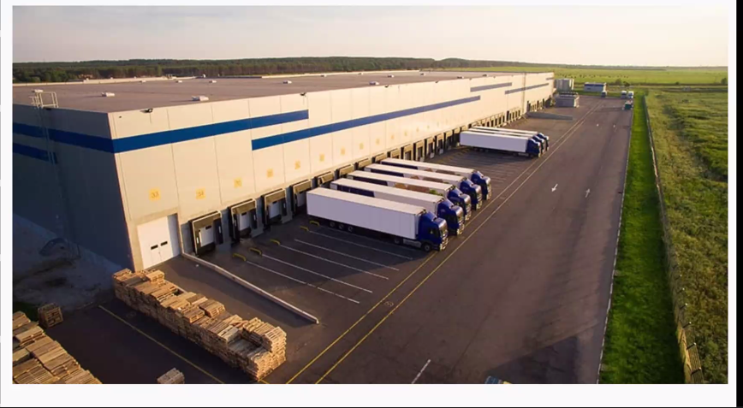
Understand the business problem first
The most important question that bothers avocado producers, wholesaler, and retailers – food items are perishable
How to save your company 1 million dollars?
Solution – use AI-driven solutions like Tableau or programming software like R to drive better decisions

Slide 14
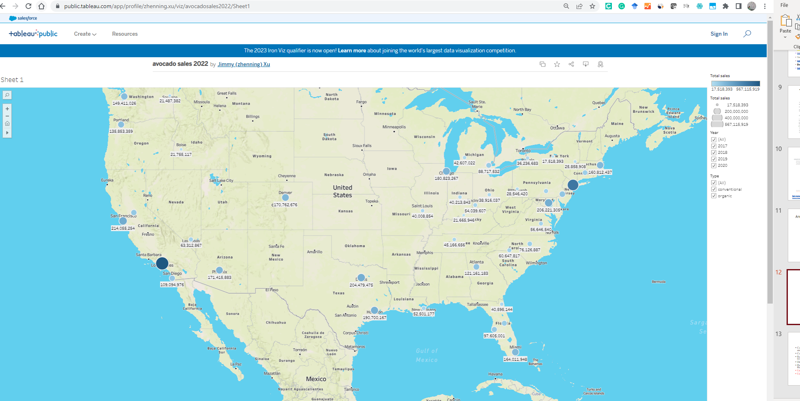
Question 1 of the case Which city has the largest sales of organic and conventional Hass avocados in the dollar amount, respectively, for each year (i.e., 2017, 2018, 2019, 2020)? Initial solution - Ref: https://public.tableau.com/app/profile/zhenning.xu/viz/avocadosales2022/Sheet1 Question for you? - Do I have the right solution for the business problem? Note- this solution is created using Tableau Public Congratulations to all of you who already posted your work
The avocado case

Slide 15
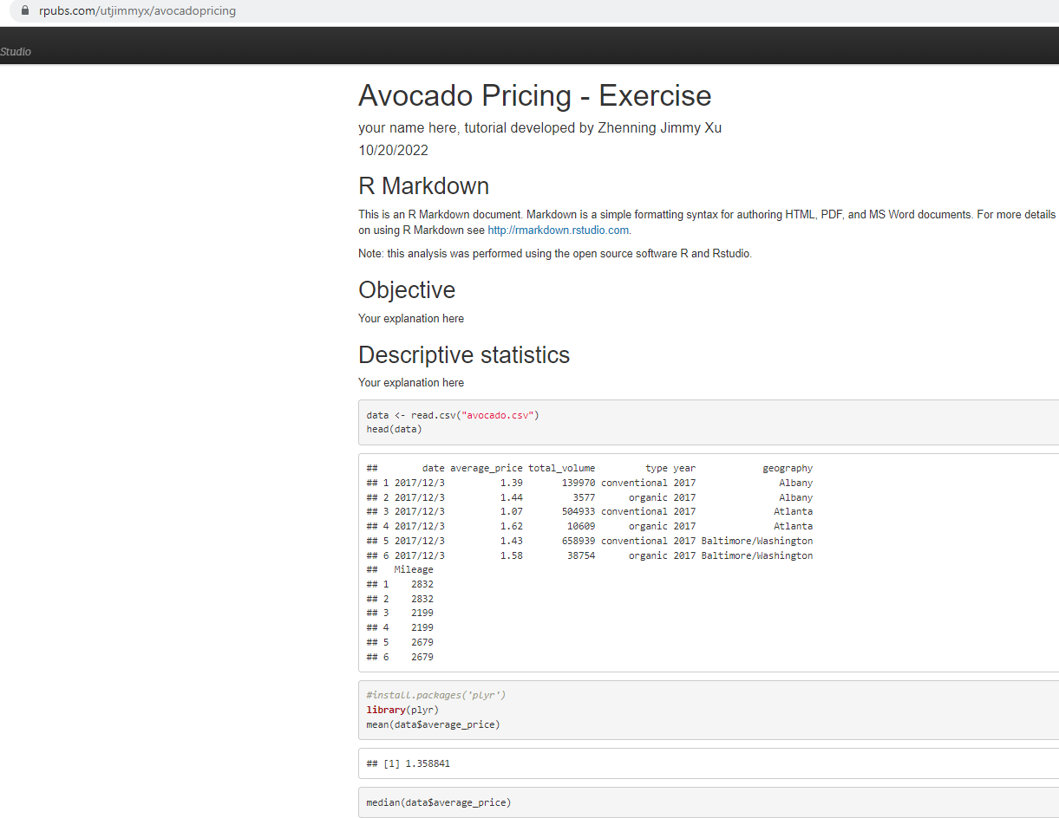
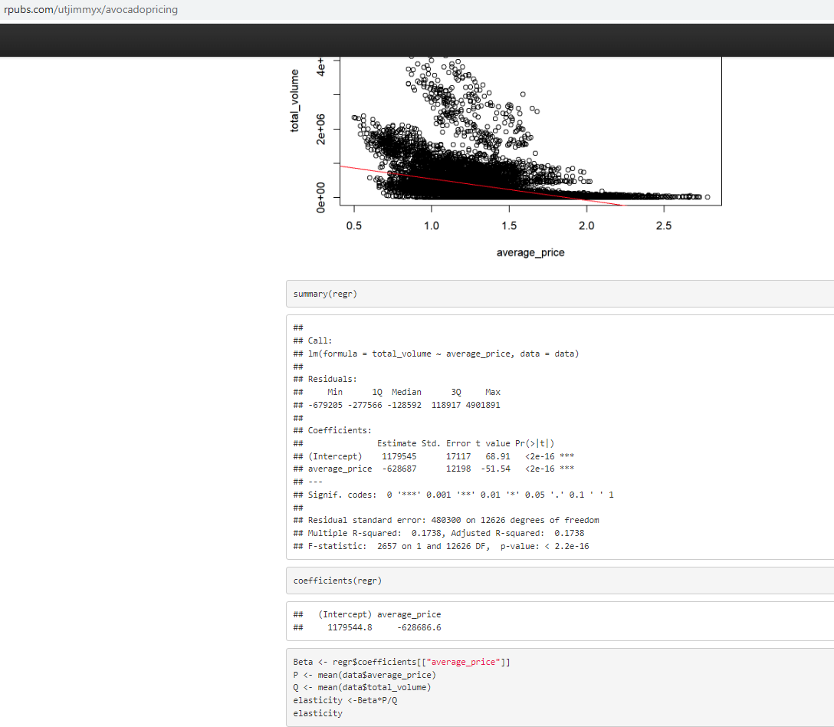
Question 2 of the case - Are there any effects of Hass avocado prices on sales volumes? You may use a pivot table (or chart) or regression analysis for this analysis. Initial solution - https://rpubs.com/utjimmyx/avocadopricing Question for you? - Do I have the right solution for the business problem?
The avocado case
Note- this solution is created using R (R studio) and R Markdown
Congratulations to those of you who already posted your work
We will work on this together next Monday in case you need any help

Slide 16
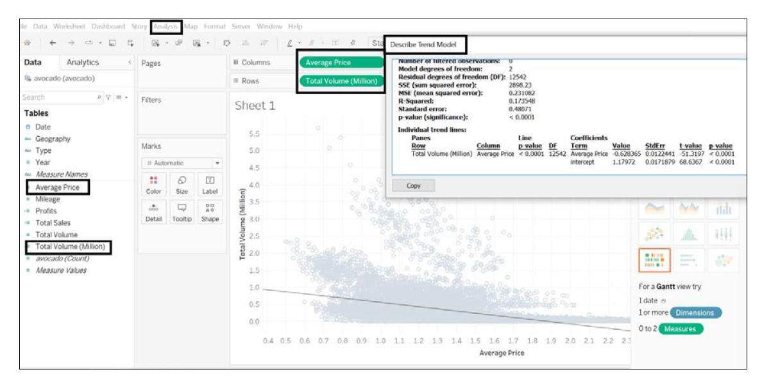
Question 2 of the case - Are there any seasonal factors that may affect Hass avocado prices and sales volume? Initial solution Question for you? - Do I have the right solution for the business problem? Note- this solution is created using Tableau Public Congratulations to all of you who already posted your work
The avocado case

Slide 17
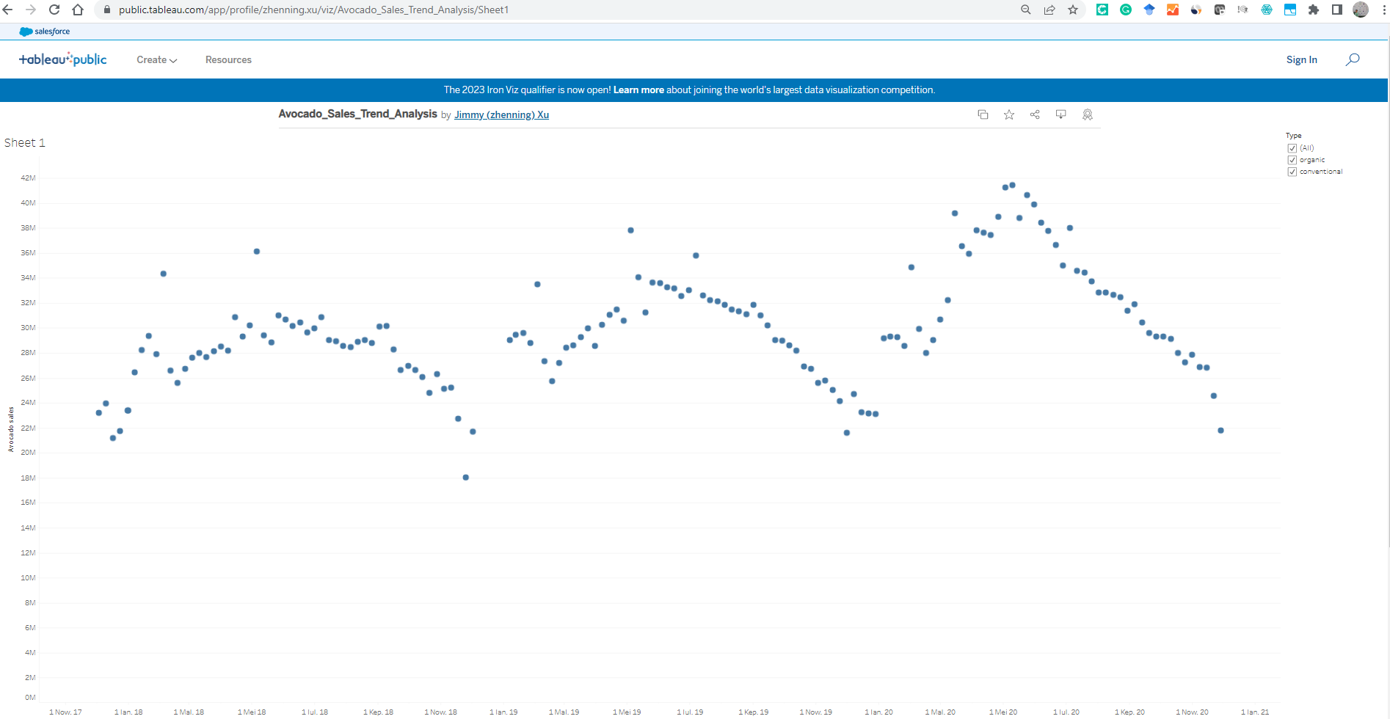
Question 3 of the case - Are there any seasonal factors that may affect Hass avocado prices and sales volume? Initial solution Question for you? - Do I have the right solution for the business problem? Note- this solution is created using Tableau Public Congratulations to all of you who already posted your work https://public.tableau.com/app/profile/zhenning.xu/viz/Avocado_Sales_Trend_Analysis/Sheet1
The avocado case

Slide 18
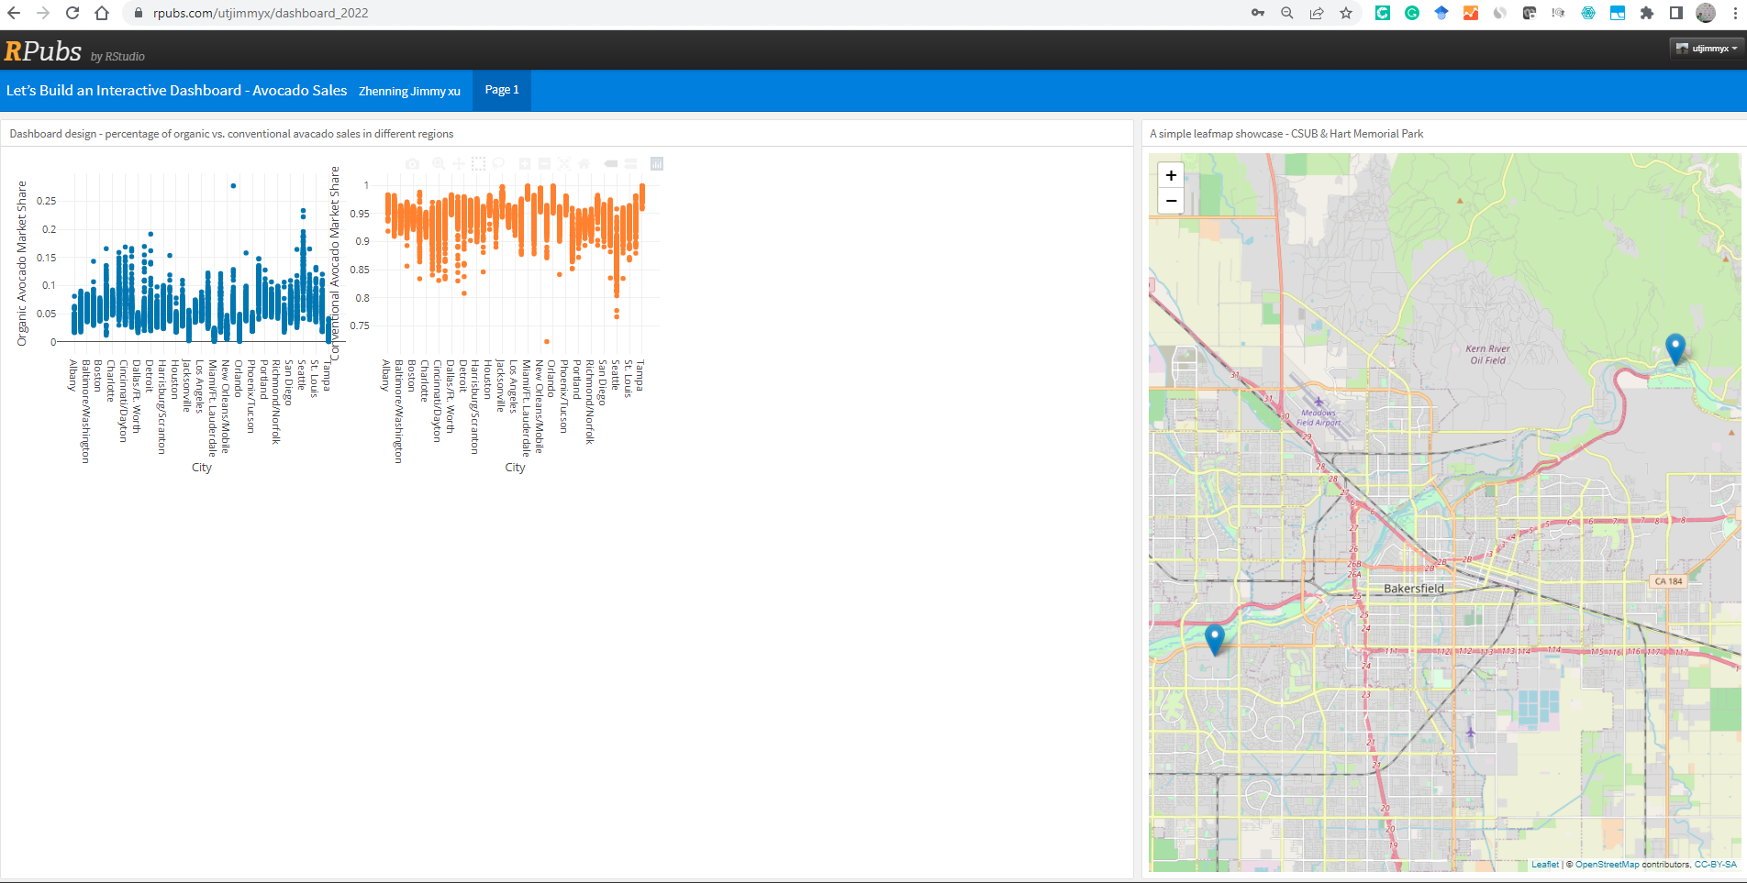
Open-ended questions – what else? Ref: https://rpubs.com/utjimmyx/dashboard_2022 Question for you? - Do I have the right solution for the business problem? Note- this solution is created using R studio and Plotly
The avocado case

Slide 19
Final wrap-up - What are you trying to accomplish?
Composition & Trend analysis – are you showing a change over time and/or parts to a whole?
Comparison – are you comparing one or more factors or variables?
Relationship – are you showing a connection or correlation between two or more variables?
Distribution – are you attempting to identify outliers and trends?
Prediction & forecasting - concerned with both the historical data and the future uncertainty
Understand the business problem first
Use your domain knowledge
Identify multiple possible solutions

Slide 20
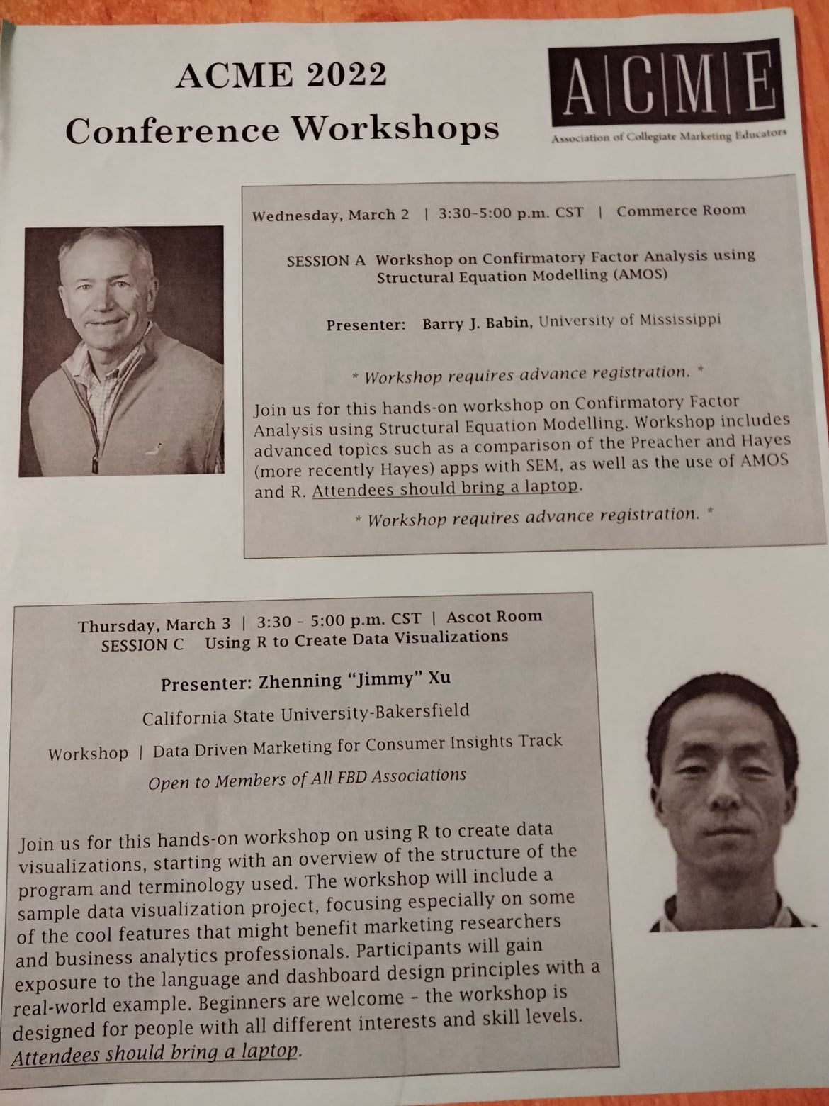
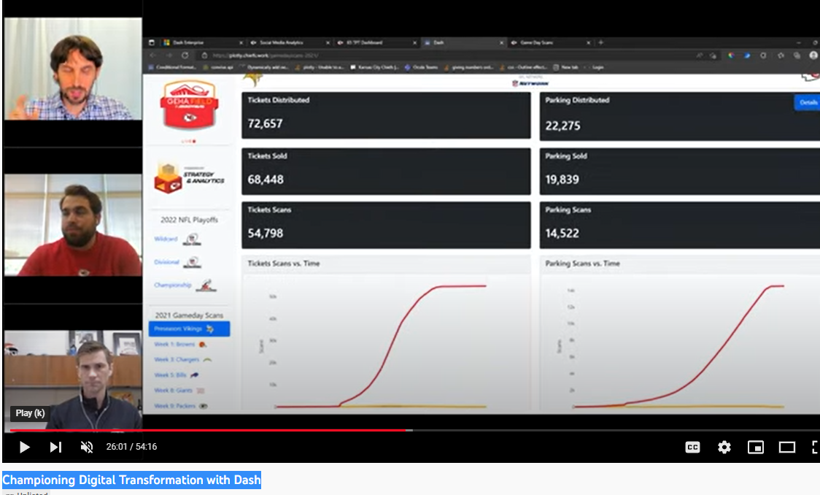
Your next steps – bring business problems and your analytics expertise together
The keynote dashboard Plotly (Dash) design workshop I offered at the ACME 2022 conference - https://rpubs.com/utjimmyx/dashboarddesign
Championing Digital Transformation with Dash (Plotly) – the Kansas City Chief’s analytics team (how we grew from 1 to 7 people in the business analytics team in a few years) - https://www.youtube.com/watch?v=w5HuLKJ7KTs

Slide 21
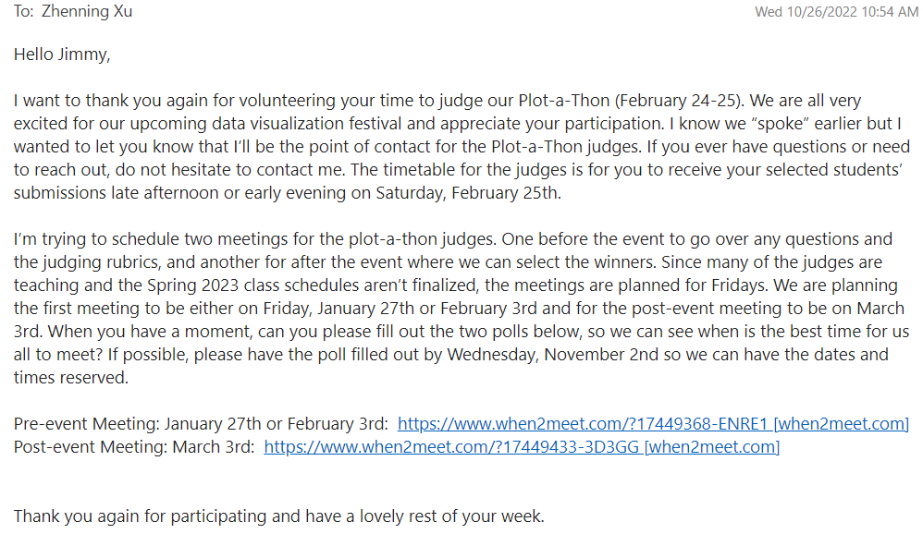
Your next steps – contact me in spring 2023 for one of these three awesome events

